Slide 1
Welcome
to
CSE331

Slide 2
About Me
Jesse Hartloff, PhD
hartloff@buffalo
Office: Davis 344
Office hours: Wednesday @ 1-3pm

Slide 3
Course Resources
Course Website
https://fury.cse.buffalo.edu/courses/cse331-u18/syllabus
Syllabus, schedule, and course content
Subreddit
https://www.reddit.com/r/cse331/
Questions, announcements, and discussion

Slide 4
Pre-requisites
Required (officially)
CSE 191: Discrete Structures
CSE 250: Data Structures
MTH 142: Calculus II
Required (for practical purposes)
Comfort with proofs
Willingness to work hard!

Slide 5
Course Structure
Lectures (2:30 – 5:30pm)
3 hours of algorithms!
Will be broken up with discussions, brainstorming, and breaks
Recitation (5:30 – 6:30pm)
Review homework and examples
Cover unclear material
Will be casual

Slide 6
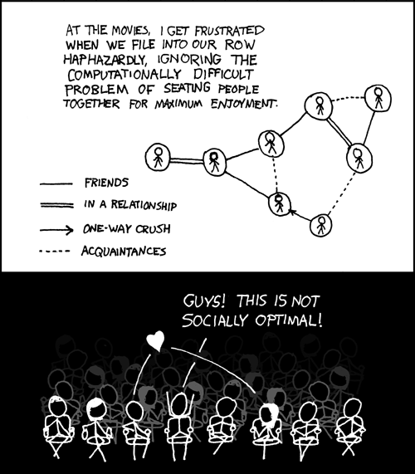
This course: how to solve problems!
http://xkcd.com/173/

Slide 7
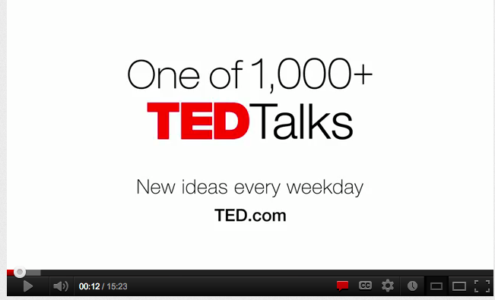
If a picture is worth 1K words

Slide 8

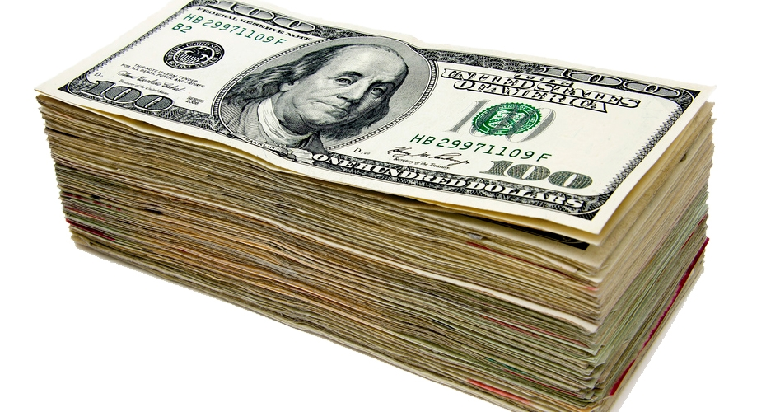


Why should I care?

Slide 9
From someone who got a job at Google
“You can let your algorithms class know that the phone interviews are essentially like a difficult algorithms test.
Lots of data structures, specifying the algorithm, analyzing the
run time and space requirements... And all on the phone and
you're supposed to talk through your thought process.”

Slide 10
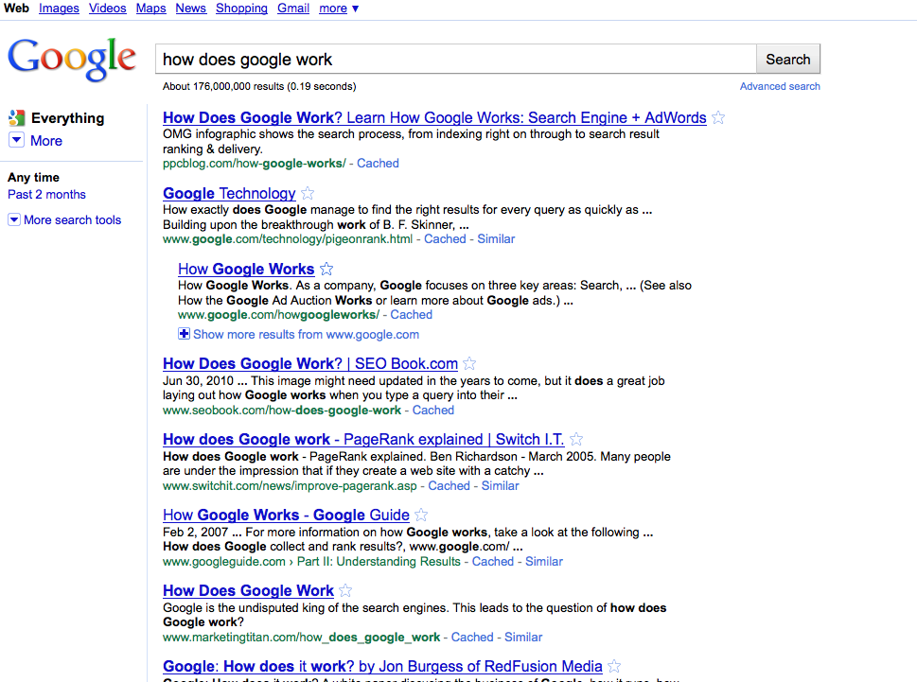
Why care about algorithms?
Google searches

Slide 11
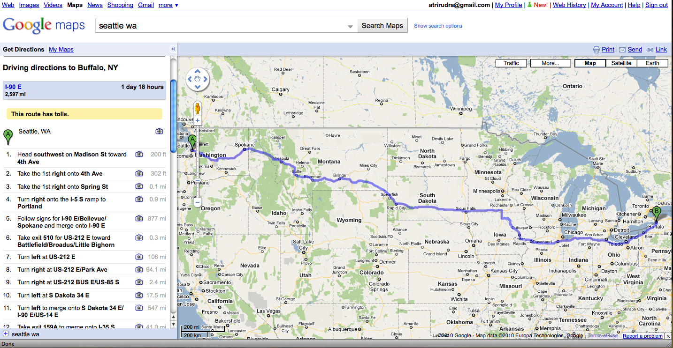
Why care about algorithms?
Driving directions

Slide 12
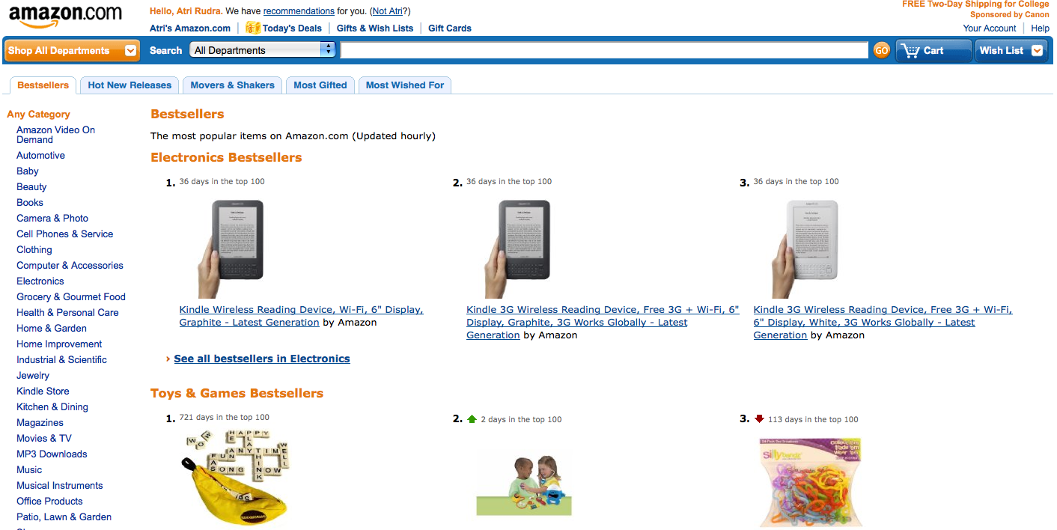
Why care about algorithms?
Computing Bestsellers on the fly

Slide 13
Amazon
How does Amazon fulfill so many orders so fast?
https://www.youtube.com/watch?v=ADgSTMla3EU
Efficiency is the key
We will see this a lot in this course
Not good enough to just solve a problem. It must be fast!
We will do lots of runtime analysis

Slide 14
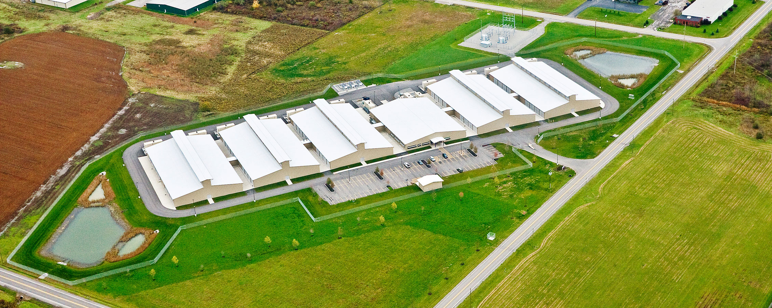
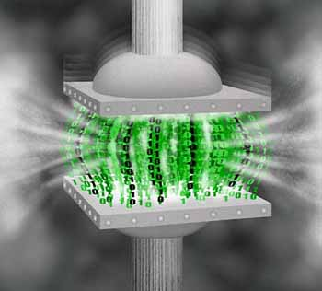
Why care about algorithms?
https://americanbuildersquarterly.com/2015/10/01/yahoo/
Data compression
http://www.di.ens.fr/~cherniav/teaching.html

Slide 15
Algorithms are everywhere
We could go through examples all semester

Slide 16
Now about the course
It will be hard!

Slide 17
We’ll do loads of
Proofs!
Writing down your thought process formally and precisely!

Slide 18
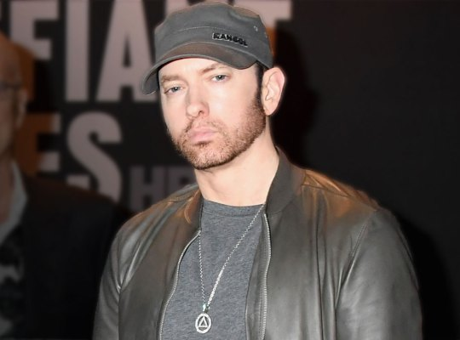
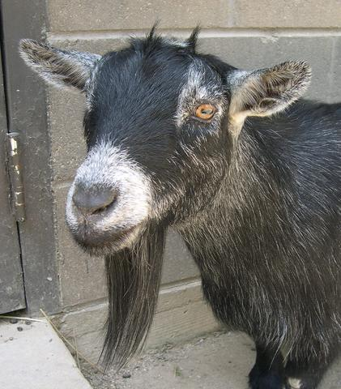
The language of proofs
Eminem has a beard
radaronline.com
Every goat has a beard
animaldiversity.org
Therefor, Eminem is a goat
Sometimes your conclusion can be true, but the proof is illogical

Slide 19
A common complaint
Your examples in class look nothing
like HW questions.

Slide 20

True because….
zazzle.com

Slide 21
False because…
HWs and exams will test your
understanding of the material

Slide 22
What I’ll strive to do
Help you with your questions and/or doubts

Slide 23
I’m not a mind reader
Tell me what you don’t understand
so I can explain it better
Post annonymously on the subreddit if you’d prefer

Slide 24
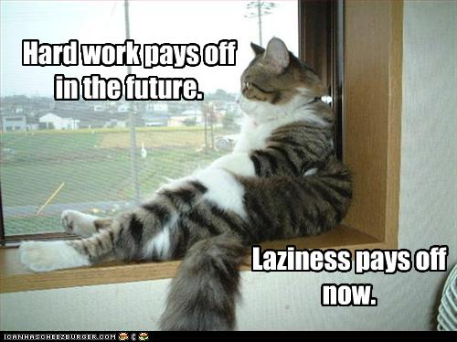
The only way to do well is to work hard

Slide 25
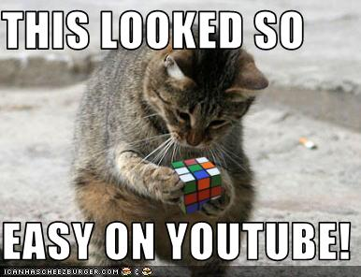
Warning: Easy != Plug n’ Chug

Slide 26
Lecture pace
Mid-term

Slide 27
What are Algorithms?

Slide 28
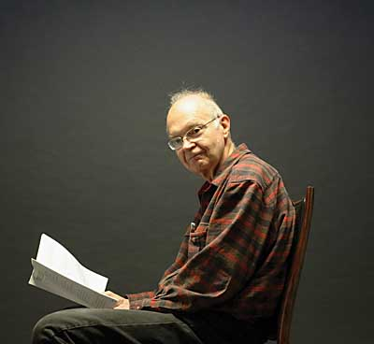

Slide 29
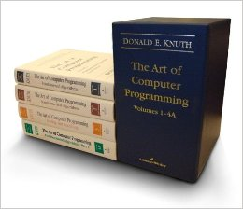
Don Knuth

Slide 30
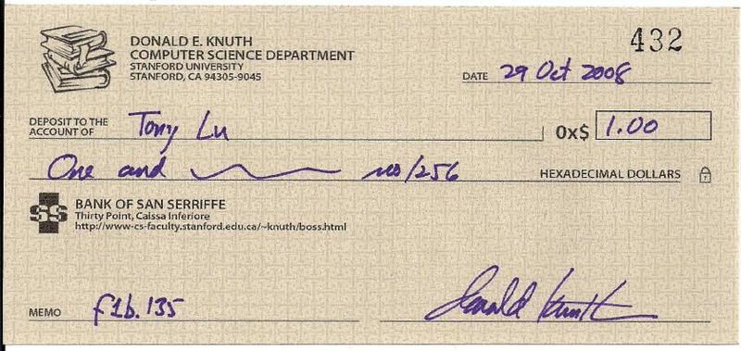
Don Knuth Reward Checks
http://www.flickr.com/photos/32184482@N03/3010989157/

Slide 31
Knuth’s Definition
An algorithm is a finite, definitive, effective
procedure with some input and some
output

Slide 32
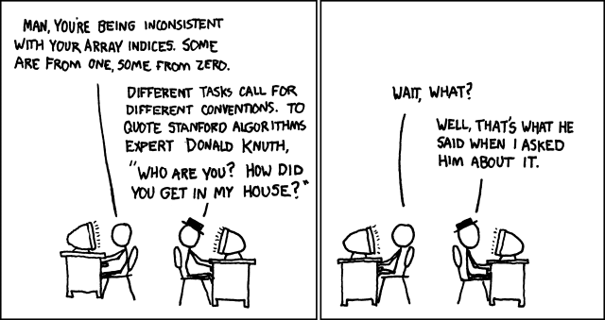

Slide 33
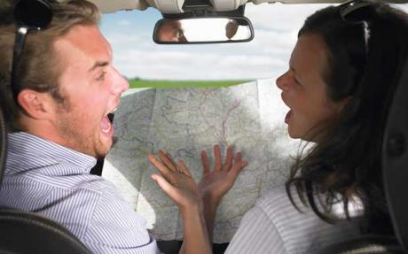

From problem to software
?
CSE331

Slide 34
Day 1 Survey
Goole Form
https://goo.gl/forms/bgqcztbQGoyRDLU82
Top 3 programming Languages
What are your hobbies?
Why Computer Science?
So I can get a feel for who you are and possibly customize examples to the classes common interests

Slide 35
Questions/Comments?

